Slide 1
Sponsorships
August 2017

Slide 2
Agenda
Definitions
IRS rules
Sponsor “Recognition” versus
Sponsor “Promotion”
Why does it matter ?
Some Guidelines
Documenting and accepting payment for Sponsorships

Slide 3
Definitions
Qualified Sponsorships versus Advertising Expense
A payment qualifies as a charitable sponsorship as long as the sponsor does not receive any substantial benefits in return.
However, if a nonprofit actively promotes a sponsor’s products and/or services, it provides the sponsor with substantial benefits in the form of advertising, thus the sponsorship becomes taxable advertising revenue.

Slide 4
IRS rules
The IRS differentiates between sponsor recognition and sponsor promotion. For this reason, nonprofits need to be careful about how they categorize sponsors.
Per IRS rules, nonprofits can acknowledge sponsors by mentioning or displaying the following: company name, company logo, product lines and contact information (address, phone number, web address). Nonprofits are also permitted to mention slogans and value-neutral descriptions (no pricing, etc.) of a sponsor’s goods or services in acknowledging their support. In addition, nonprofits can display or distribute a sponsor’s products to the general public at the sponsored activity or event.

Slide 5
IRS Rules, cont.
The IRS defines “Advertising” (thus sponsor “promotion”) as any sponsor recognition or message that includes the following:
Qualitative or comparative language;
Price information or indications of saving or value, or
A call to purchase, sell or use the sponsor’s products or services (i.e. order forms, links to sponsor website to order products,etc.).
As such, you want to avoid providing coupons, endorsements, or comparisons to a sponsor’s competitors at the sponsored activity or event.

Slide 6
Why does it matter?
Sponsor “promotion” or advertising is considered income to UCSD and can be subject to “Unrelated Business Income Tax”.
Proper donor stewardship. When setting up Sponsorships for an event, conference, etc., sponsor benefits need to be clearly defined and vetted to manage donor expectations as to whether their sponsorship will be tax deductible or not.

Slide 7
Some Guidelines
“Acceptable” Benefits for a Sponsorship to be a “Qualified” Sponsorship
1. Company name and logo placement in
Official event program, event printed materials, event website, event T- shirts, banners, etc. (AKA: Donor Stewardship/thank you )
2. Sponsor recognition at event opening remarks,etc.
3. Company “give-aways” of product or display of product at event
4. Event Tickets (note- there may be a non- deductible component to these (dinner, hotel rooms, etc. that needs to be disclosed to the sponsor in writing)
5. Opportunity to judge event based competitions

Slide 8
Some Guidelines, cont.
Sponsorship benefits that may classify as “Advertising”
Vendor booth/tables where sponsor can sell product, provide price lists, provide order forms, etc.
Links to sponsor website to order/buy products from event website
Endorsements for sponsor’s product over other comparable products
Inducements to purchase, sell, or use the products or services
Coupons for discounted prices for sponsor products

Slide 9
Documenting and Accepting Payments for Sponsorships
If a Sponsorship qualifies as a gift, a solicitation letter with the Sponsorship amount and acceptable benefits should be sent to potential sponsors. A sample letter for a simple Sponsorship solicitation letter with “acceptable benefits” follows.
For Sponsorships that have various levels and also have non-tax deductible benefits, please contact Gift Processing for help.

Slide 10
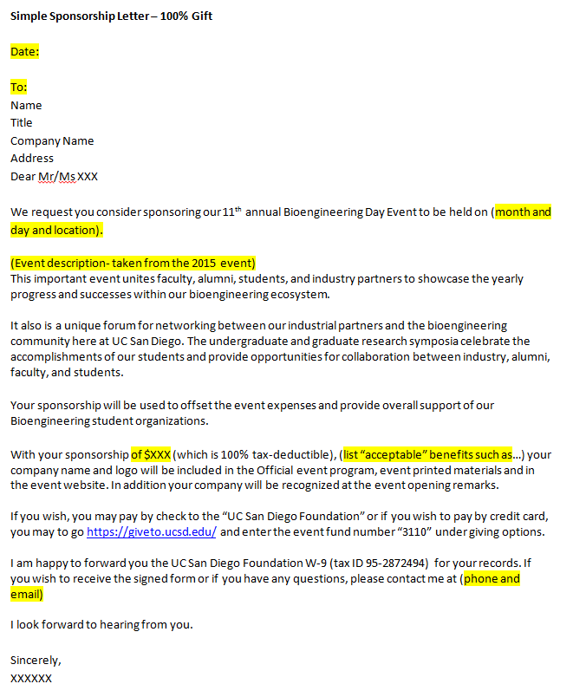
Documenting and Accepting Payments for Sponsorships

Slide 11
Documenting and Accepting Payments for Sponsorship
Payments for sponsorships that qualify as gifts must be directed to the Gift Processing Office, either by checks or by directing the sponsor to the UC San Diego giving website https://giveto.ucsd.edu/. A link to the event fund number can set up to take the sponsor directly to the fund.
DO NOT set up a PayPal account or other method of payment as we may not be able to process it as a gift. Also if payment is directed to you personally, it could trigger personal taxable income.

Slide 12
Documenting and Accepting Payments for Sponsorship
If the Company wishes to sponsor an event with benefits that qualify the sponsorship as advertising, work with your Business Officer to set up and handle the payment, as it will not be processed as a gift.

